Slide 1


Capstone Project : A Profound Analysis of Northwind Sales Data

Slide 2

Introduction
Welcome to our presentation, "Capstone Project : A Profound Analysis of Northwind Sales Data" .In today's data-driven world, businesses thrive on informed decisions. Our analysis delves deep into Northwind Traders' operations, uncovering valuable insights from customer behavior, order trends, employee performance, and supplier interactions. Through this journey, we'll explore how these insights empower Northwind Traders to enhance customer satisfaction, optimize operations, and drive strategic growth. Join us as we unravel the transformative potential of data analytics, shaping a future of innovation and prosperity for Northwind Traders. Thank you for your presence; let's navigate this path to success together.

Slide 3
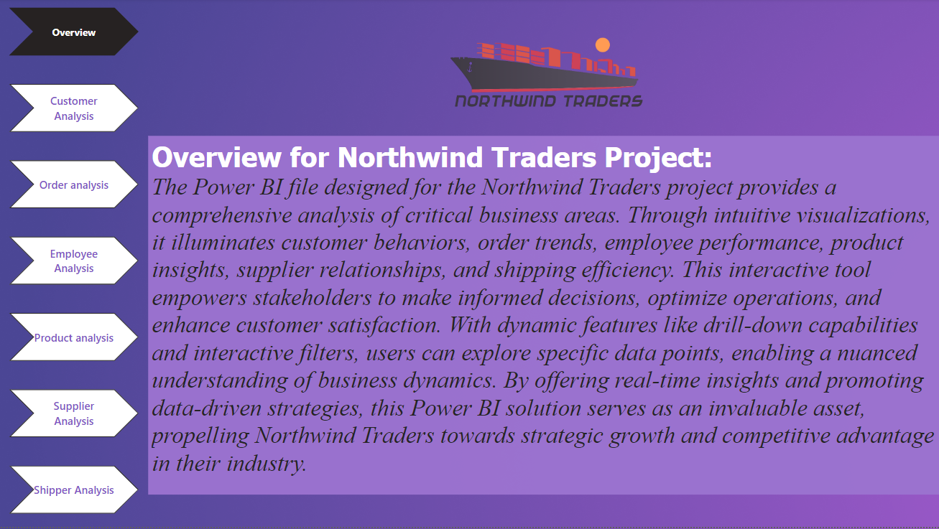

Slide 4
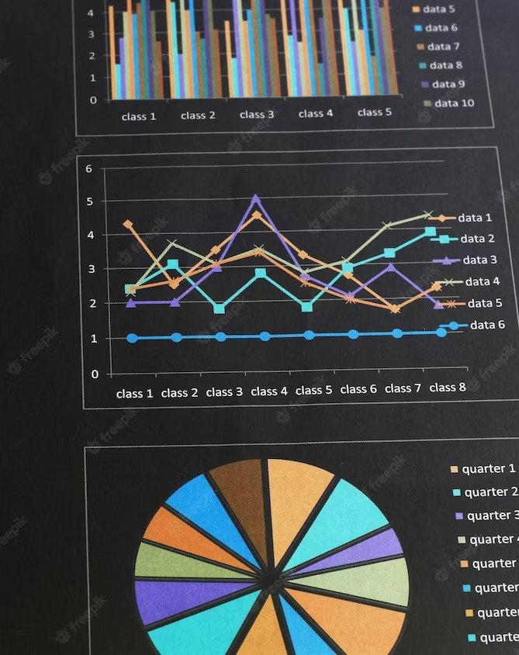
Understanding the ER Diagram
In this section, we explore the Northwind Traders dataset through the lens of Entity-Relationship (E-R) diagrams. This visual guide unveils the intricate connections between customers, orders, products, employees, suppliers, and shippers within the database. By comprehending these relationships, we gain profound insights into Northwind Traders' data structure. This understanding is pivotal, laying the groundwork for strategic decision-making and business optimization. Join us as we decode the complexities of the Northwind Traders dataset, empowering ourselves with knowledge that drives informed decisions and operational efficiency. Thank you for your presence; let's unravel the data intricacies together.

Slide 5
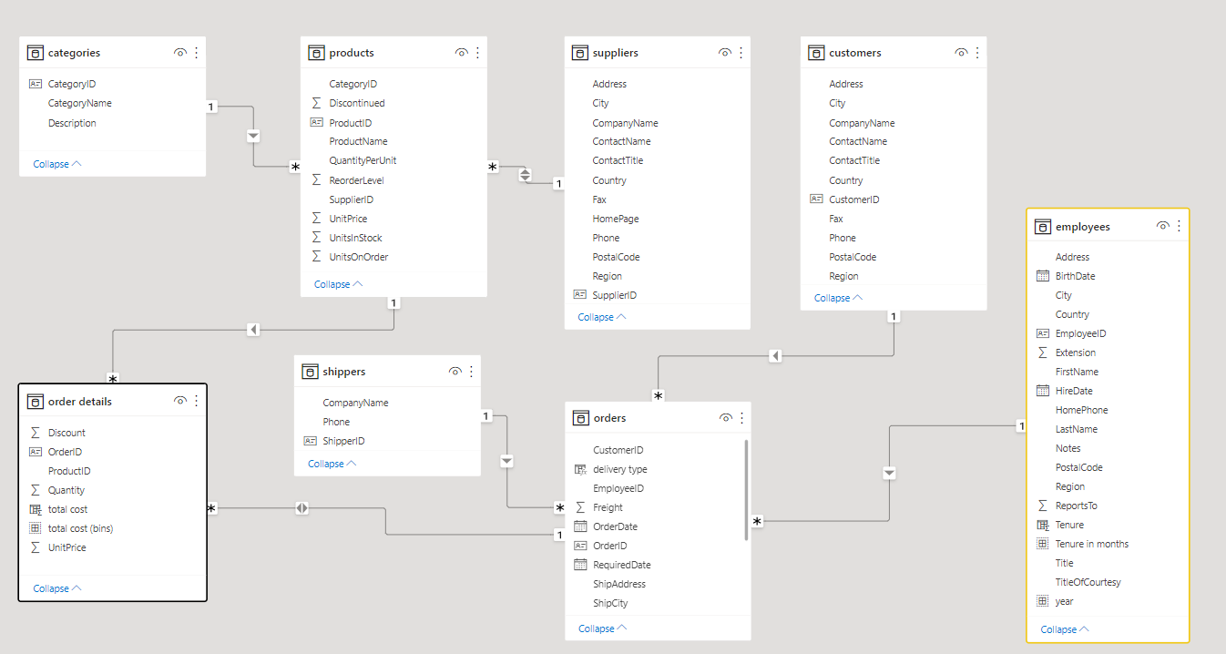

Slide 6


E ploratory Data Analysis in Power BI
Delve into the initial phase of our analysis as we conduct exploratory data analysis to uncover patterns, anomalies, and relationships within the Northwind sales data. Gain insights into customer behavior, product performance, and sales trends.

Slide 7
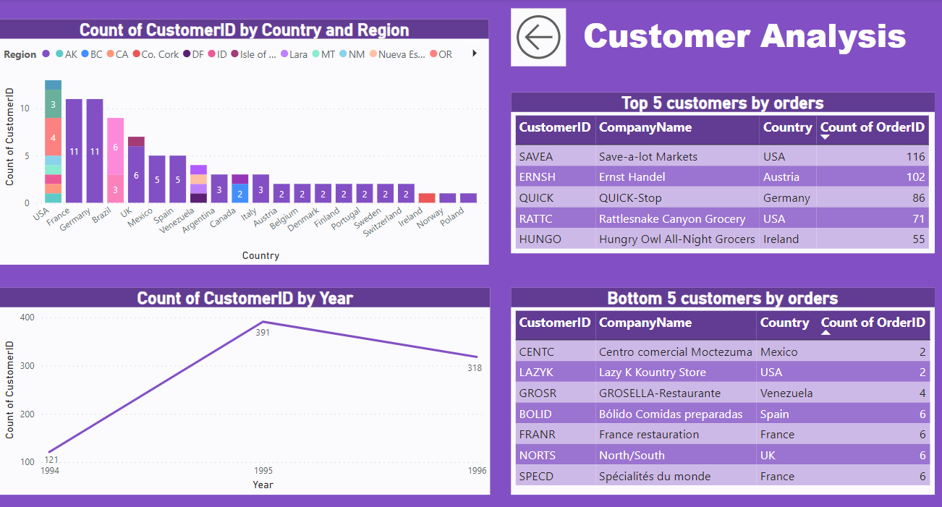

Slide 8
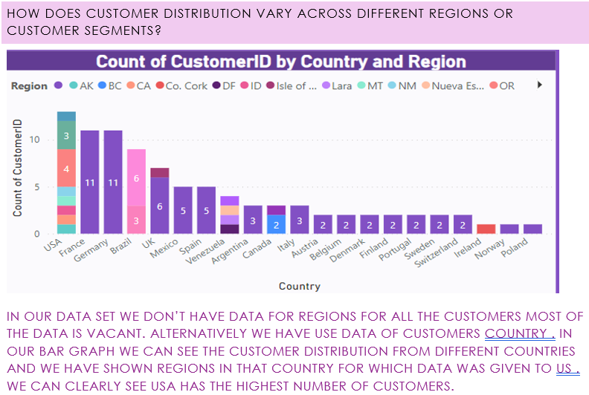

Slide 9
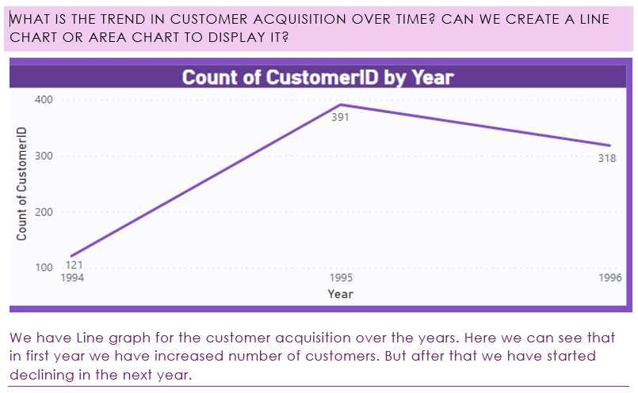

Slide 10
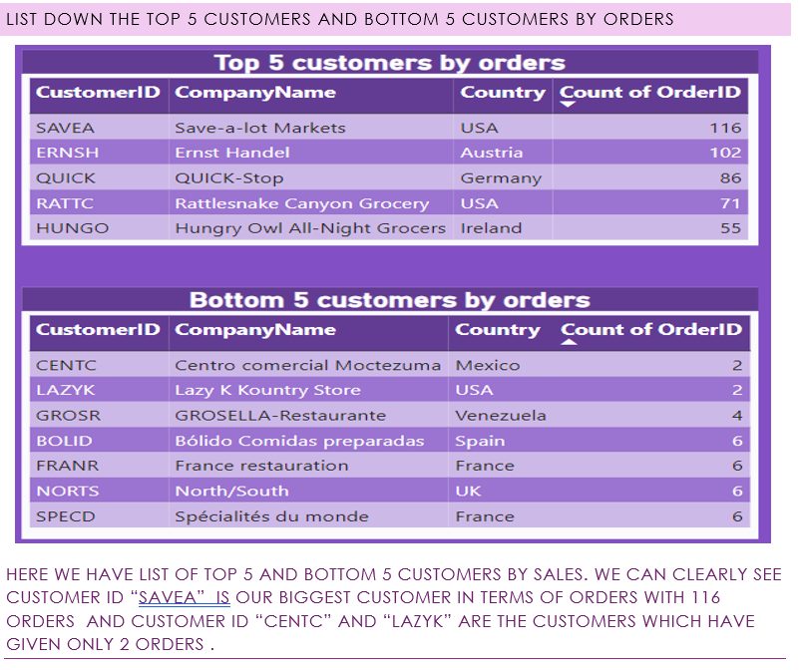

Slide 11
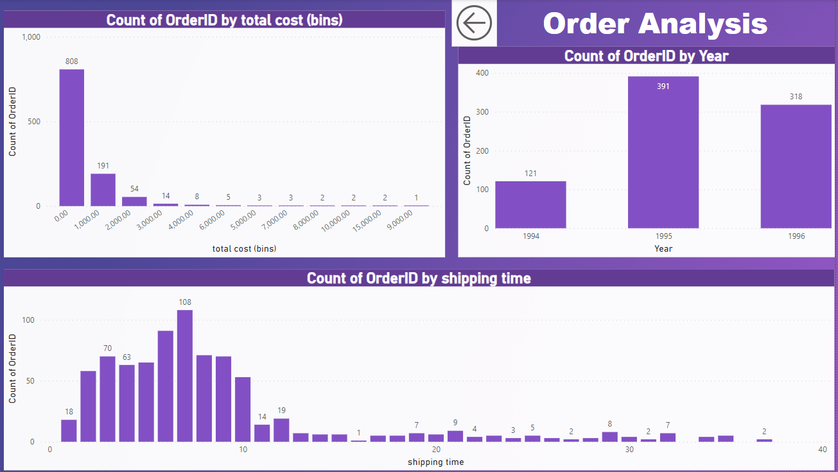

Slide 12
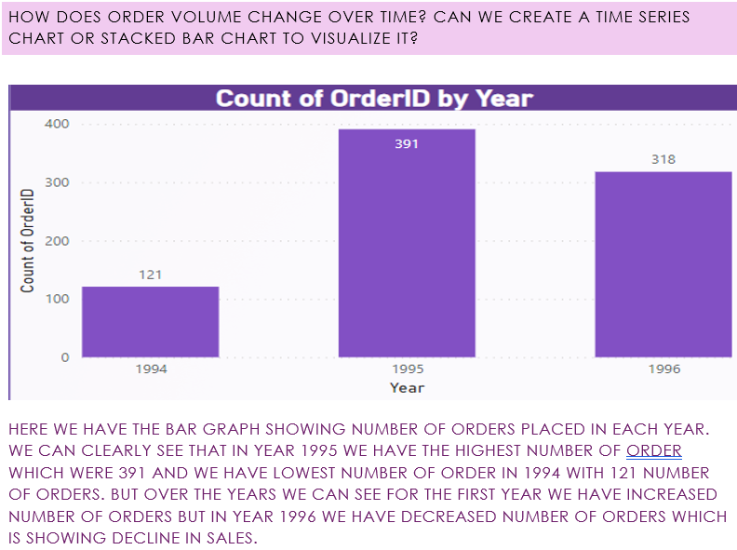

Slide 13
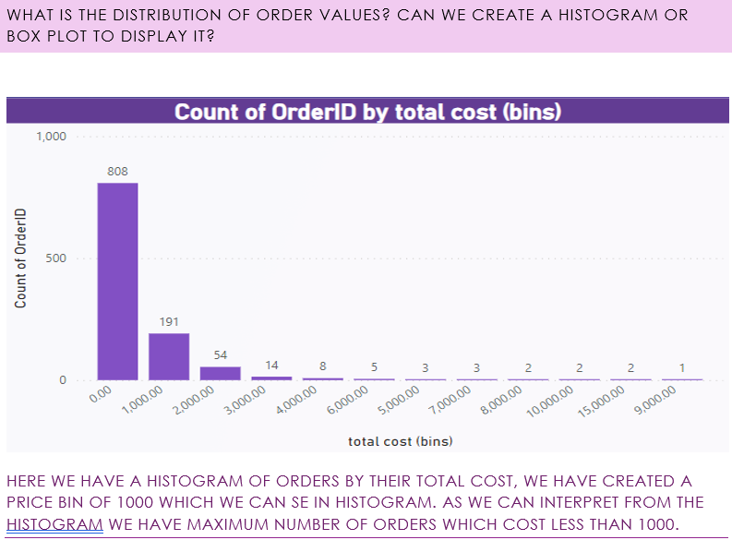

Slide 14
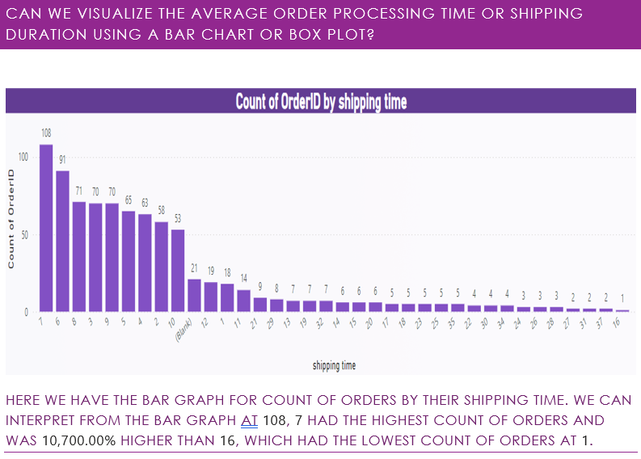

Slide 15
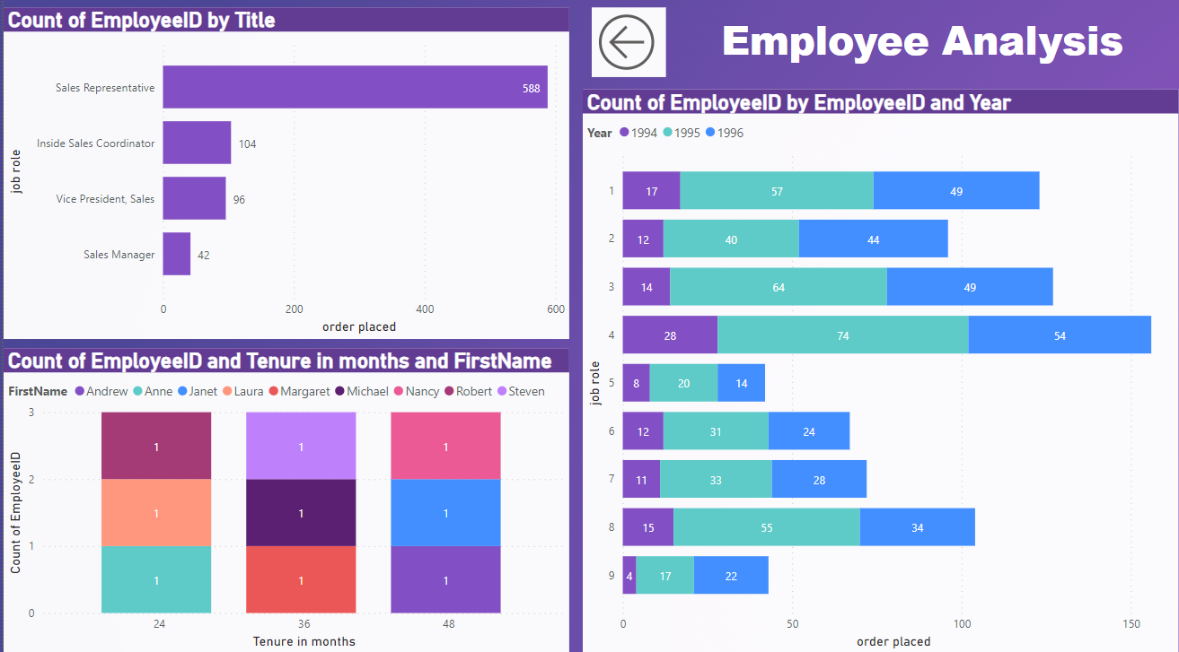

Slide 16
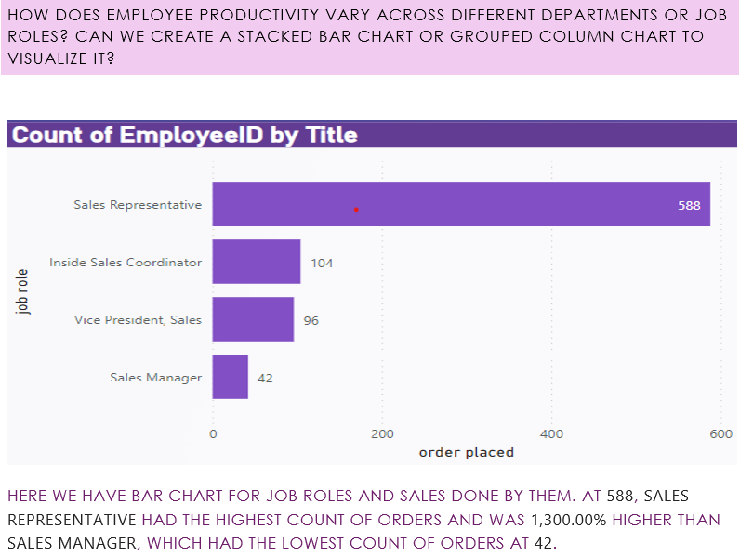

Slide 17
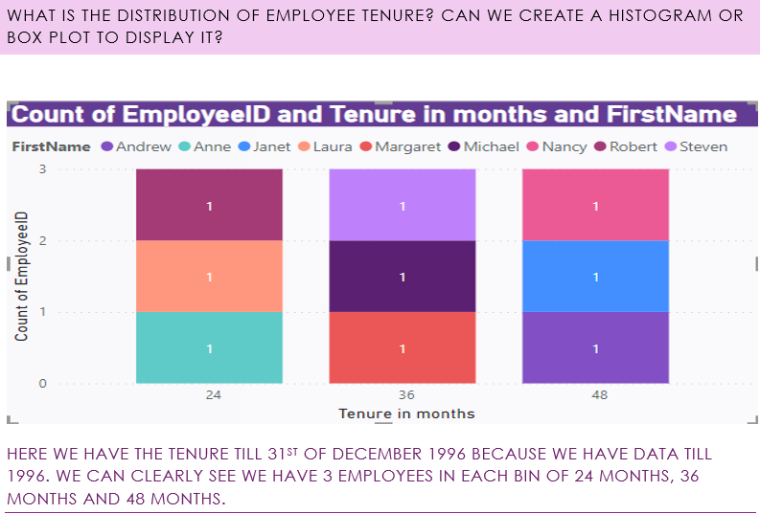

Slide 18
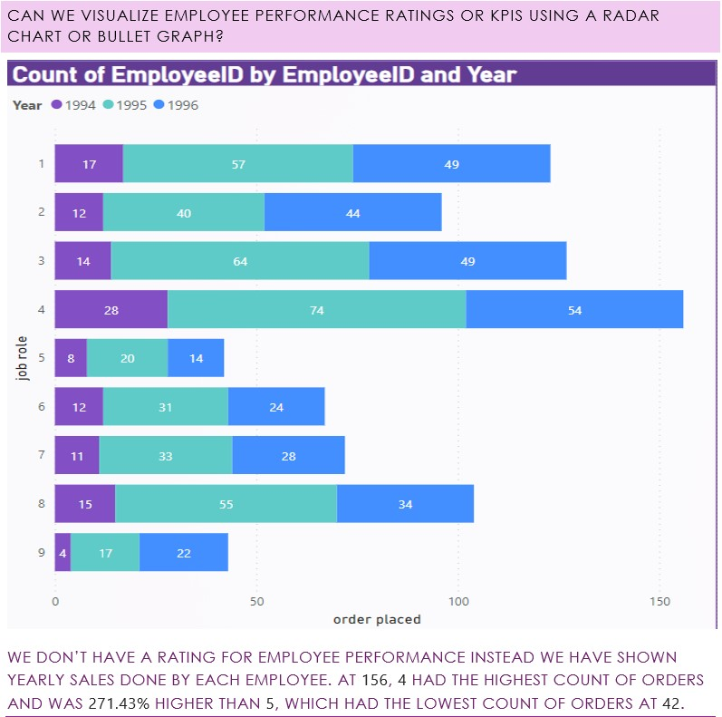

Slide 19
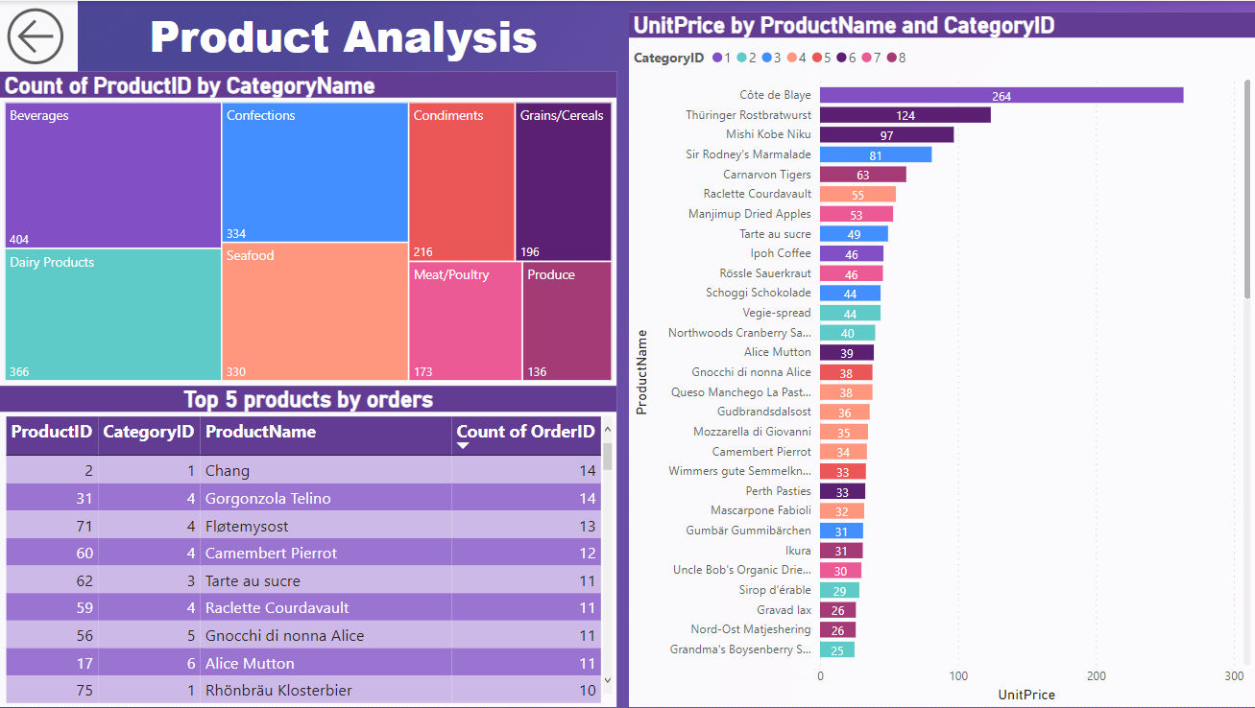

Slide 20
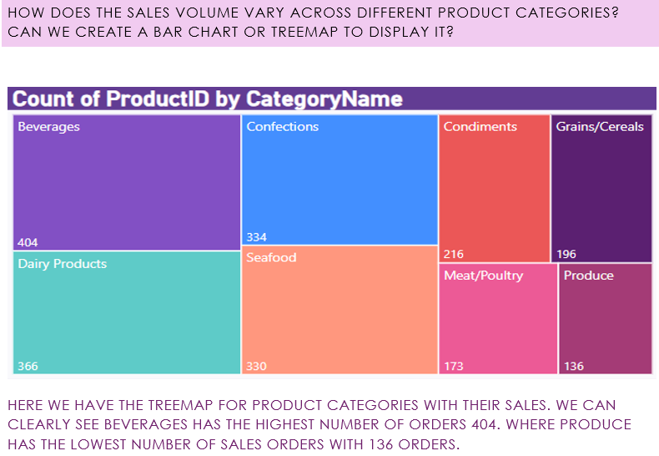

Slide 21
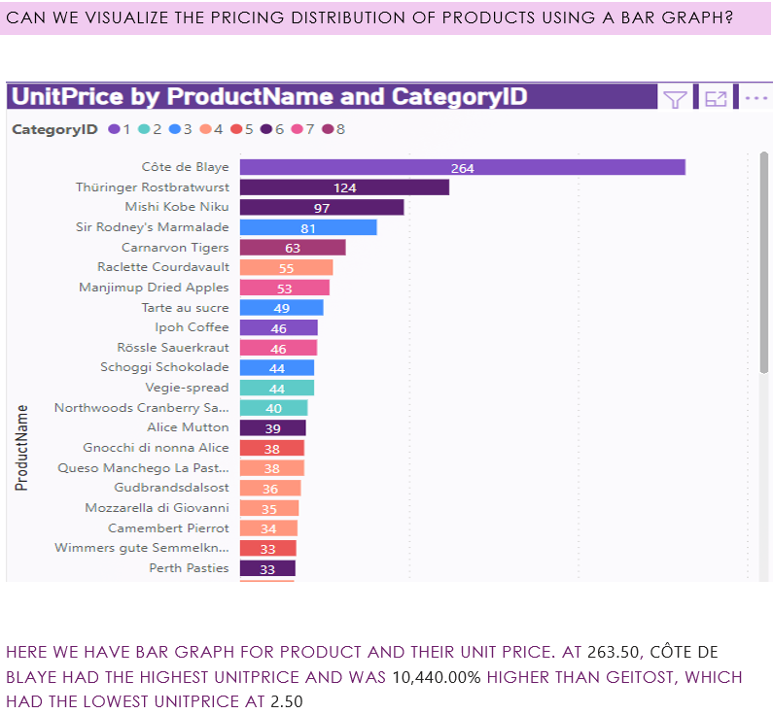

Slide 22
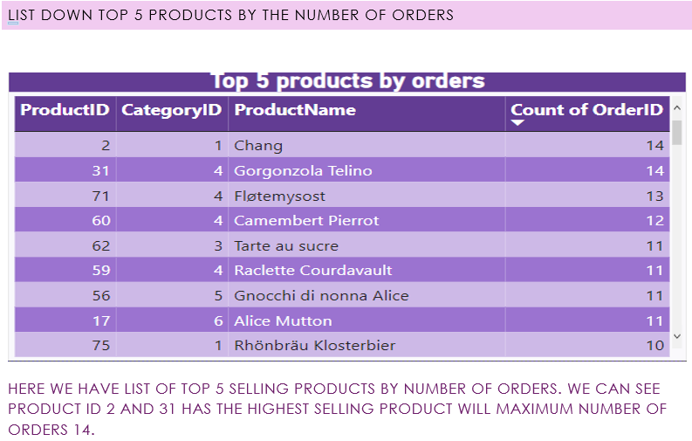

Slide 23
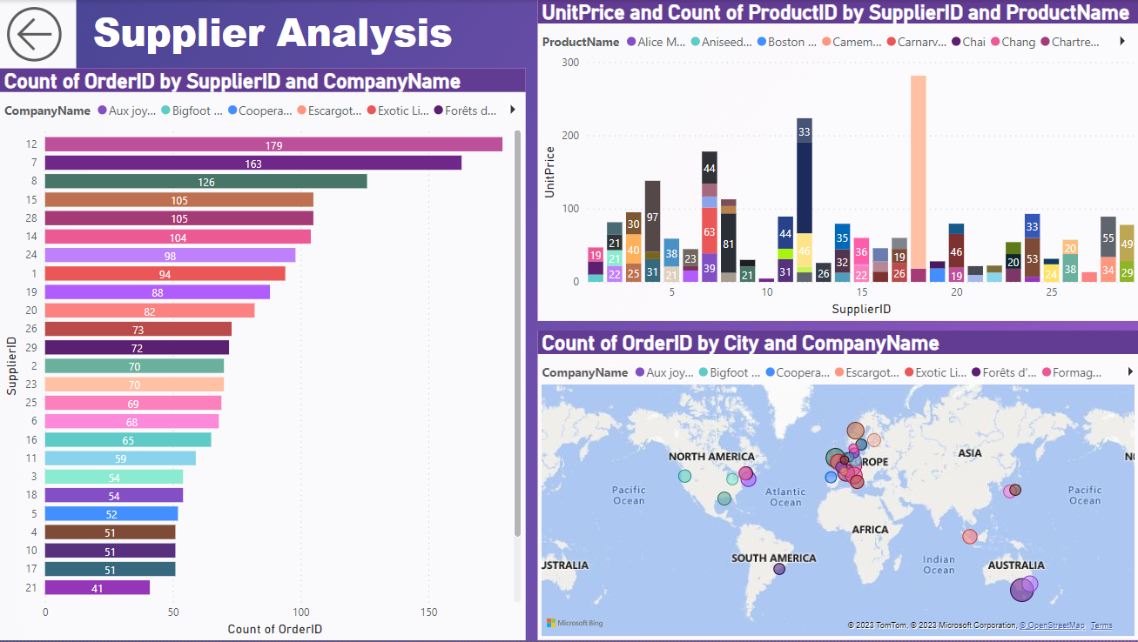

Slide 24
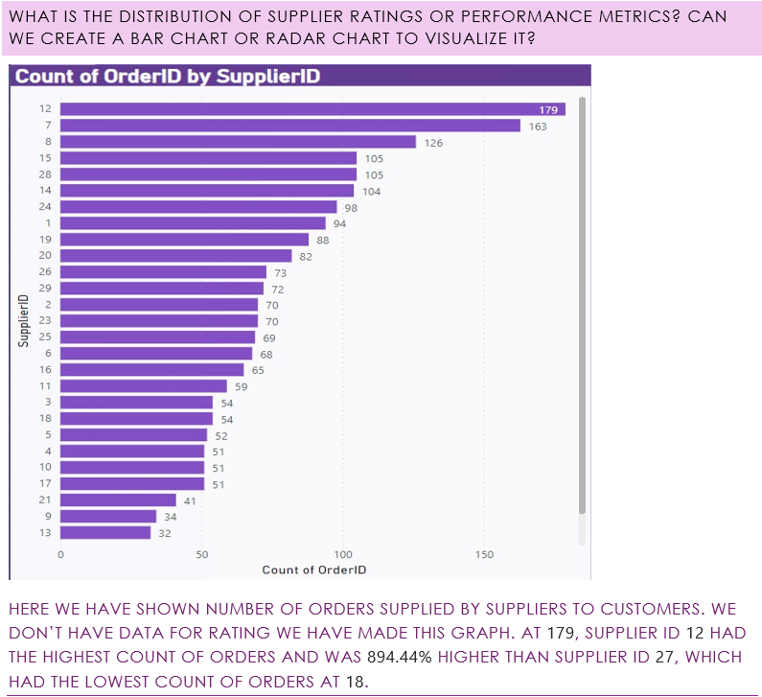

Slide 25
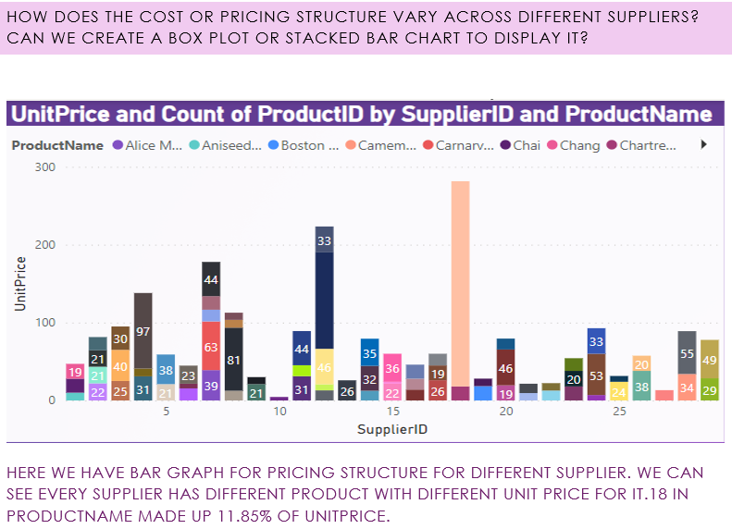

Slide 26
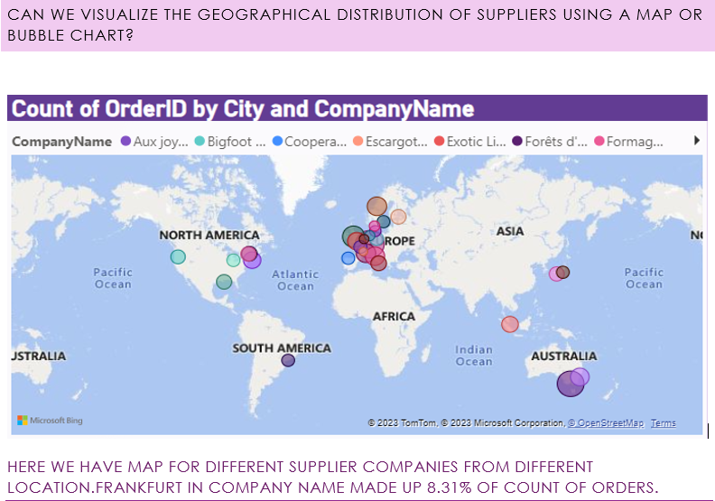

Slide 27
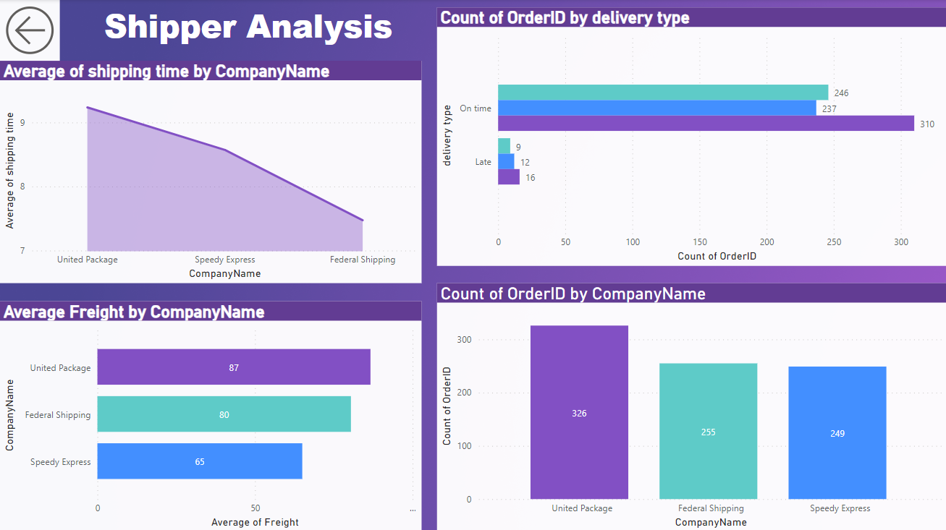

Slide 28
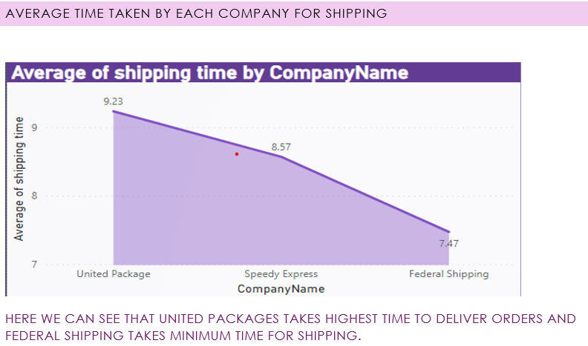

Slide 29
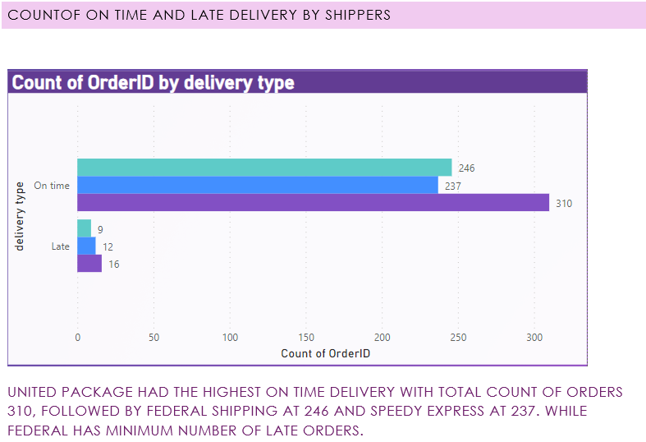

Slide 30
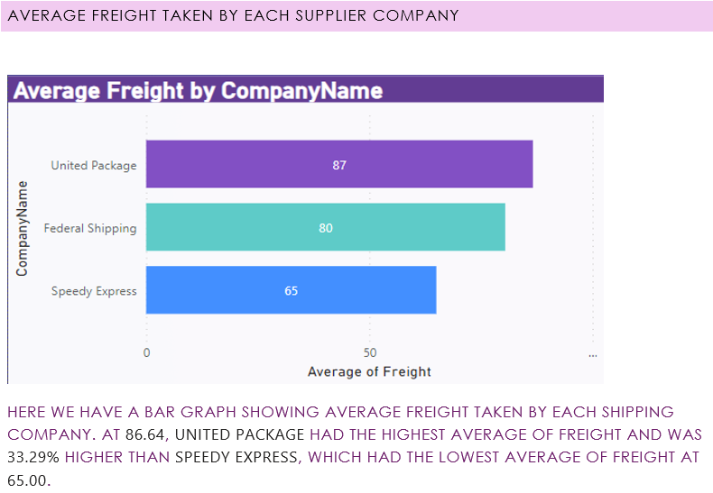

Slide 31
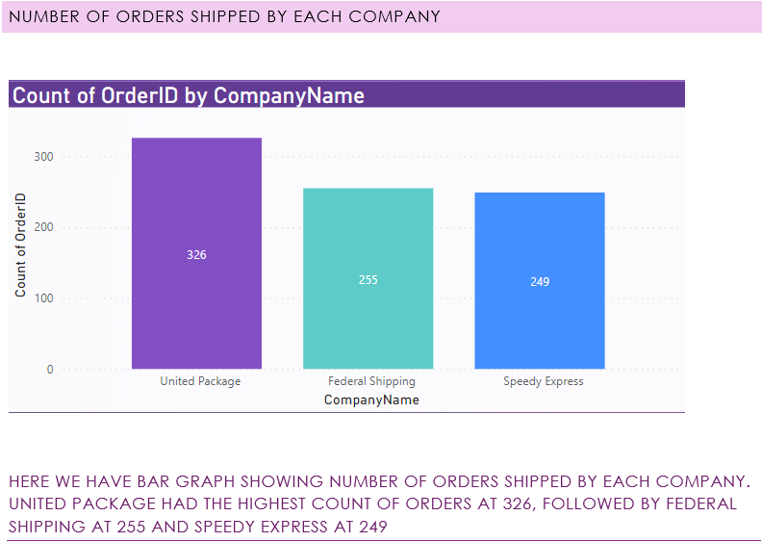

Slide 32
E ploratory Data Analysis in Using MySQl and Excel
Delve into the initial phase of our analysis as we conduct exploratory data analysis to uncover patterns, anomalies, and relationships within the Northwind sales data. Gain insights into customer behavior, product performance, and sales trends.

Slide 33
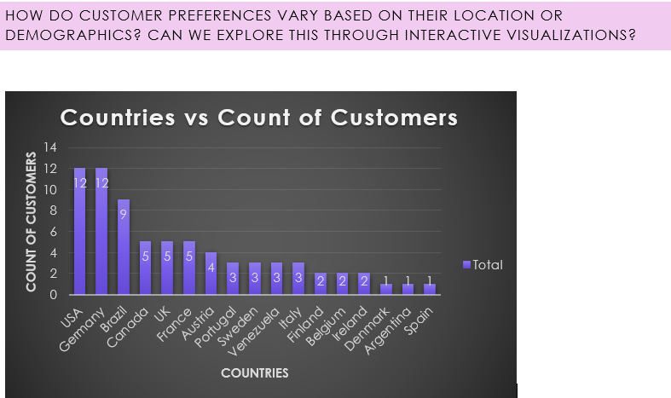
How do customer preferenHOW DO CUSTOMER PREFERENCES VARY BASED ON THEIR LOCATION OR DEMOGRAPHICS? CAN WE EXPLORE THIS THROUGH INTERACTIVE VIHow do customer preferences vary based on their location or demographics? Can we explore this through interactive visualizations? SUALIZATIONS? ces vary based on their location or demographics? Can we explore this through interactive visualizations?
The analysis of performance metrics across various countries reveals notable disparities, with Germany and the USA exhibiting the highest metrics and Denmark and Poland demonstrating comparatively lower performance. The data suggests potential opportunities for targeted expansion strategies in high-performing regions, while emphasizing the need for focused initiatives to address challenges in underperforming markets. A comprehensive understanding of the underlying factors influencing these variations can facilitate the development of tailored approaches to maximize market potential and drive sustainable growth in the respective regions

Slide 34
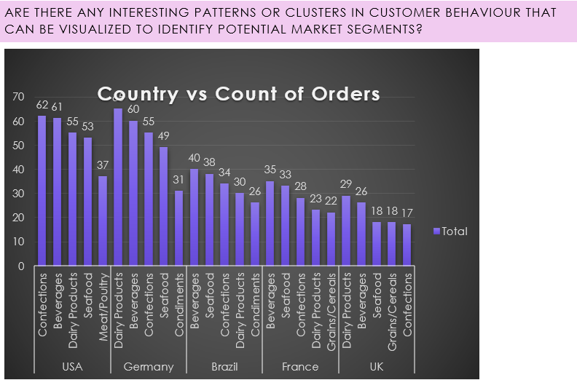
In the dataset, we don't have market segments to carryout analysis. Alternatively we have done analysis on customers countries .Here we have show top 5 Countries with higher numbers of orders and for detailed analysis we have shown top 5 product categories and their contribution in orders from that country . So, that we can easily see which product category has potential market in different Country.

Slide 35
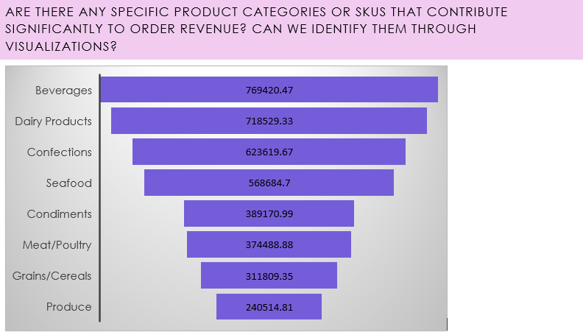
Beverages Lead Revenue: Beverages generate the highest revenue, emphasizing their significance within Northwind Traders product lineup.
Competitive Dairy and Confections: Dairy Products and Confections closely follow Beverages in revenue generation, indicating their importance as strong revenue drivers.
Promising Categories: Seafood and Condiments contribute notable revenue, presenting opportunities for targeted growth strategies.

Slide 36
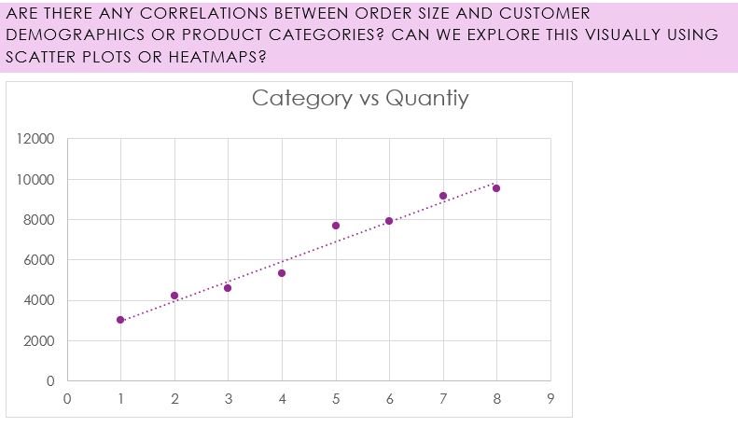
High Demand Categories: Beverages and Dairy Products demonstrate the highest quantities sold, indicating strong and consistent consumer demand.
Significant Interest: Confections and Seafood also show substantial quantities sold, reflecting consistent market appeal and consumer interest.
Stable Demand: Condiments and Grains/Cereals maintain stable demand, indicating consistent market interest in these categories.
Promising Potential: Meat/Poultry and Produce show promising demand, suggesting opportunities for targeted marketing and potential growth.

Slide 37
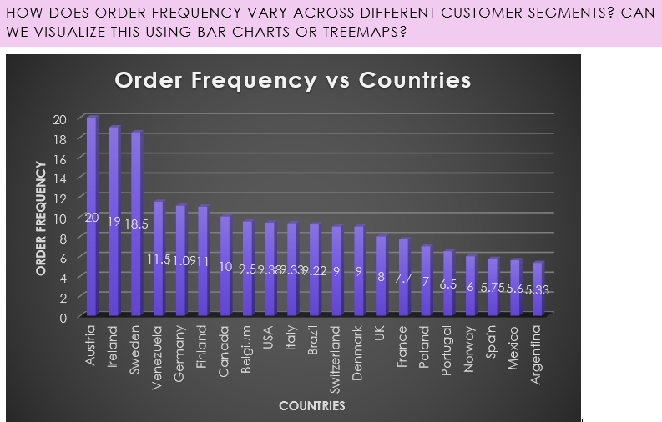
High Demand Countries: Austria, Finland, Ireland, Sweden, and Venezuela demonstrate consistently high order frequencies, indicating strong market engagement.
Stable Markets: Belgium, Brazil, Canada, Denmark, Germany, Italy, Switzerland, and the USA maintain stable order rates, reflecting reliable customer engagement.
Potential Growth: Argentina, France, Mexico, Norway, Poland, Portugal, Spain, and the UK show moderate order frequencies, suggesting opportunities for targeted expansion strategies.

Slide 38
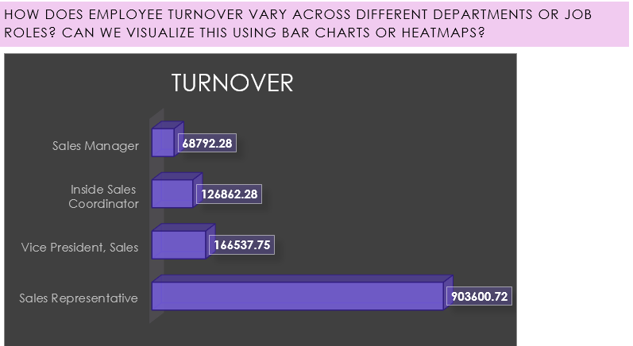
High Turnover: Sales Representative department shows the highest turnover, indicating a need for targeted retention strategies.
Moderate Turnover: Inside Sales Coordinator department demonstrates moderate turnover, suggesting the need for initiatives to enhance job satisfaction.
Low Turnover: Sales Manager and Vice President, Sales departments exhibit lower turnover, emphasizing the importance of maintaining employee satisfaction and career development opportunities.

Slide 39
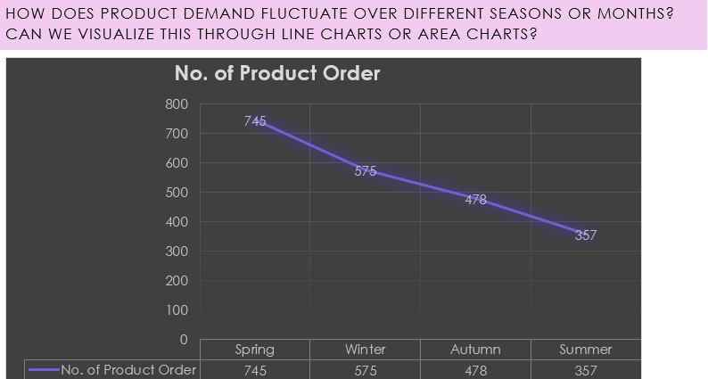
Spring Dominance: Spring records the highest number of product orders, indicating a peak in customer demand during this season.
Winter Follows Spring: Winter follows closely behind Spring in the number of product orders, suggesting sustained consumer activity during the colder months.
Autumn and Summer Orders: Autumn and Summer demonstrate relatively lower product orders, highlighting potential areas for targeted marketing and promotional strategies to stimulate demand during these seasons.

Slide 40
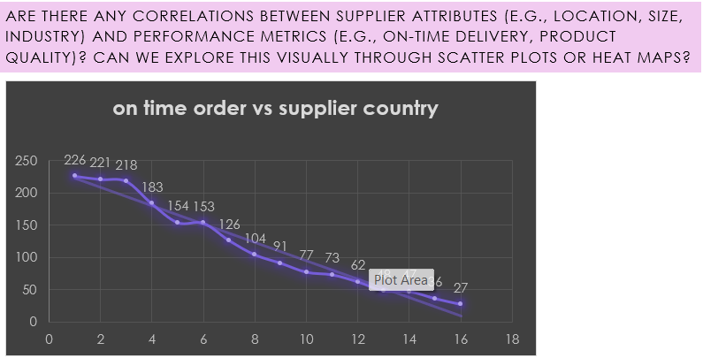
Efficient Deliveries: The USA, Australia, and Germany demonstrate the highest number of orders delivered on time, indicating efficient delivery systems and processes in these countries.
Moderate Performance: The UK, Italy, and France show a moderate number of orders delivered on time, signifying a need for potential improvements in the delivery process to ensure timely deliveries and customer satisfaction.
Opportunities for Improvement: Countries such as Canada, Japan, and Norway display a comparatively lower number of orders delivered on time, highlighting areas for potential enhancements in the delivery process to meet customer expectations and improve service quality.

Slide 41
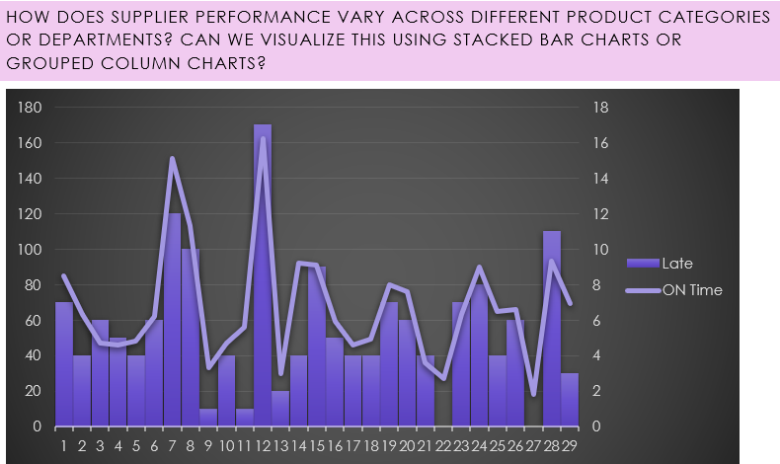
Timely Deliveries: The majority of orders across different categories were delivered on time, reflecting a generally efficient delivery process and adherence to delivery schedules.
Occasional Delays: Some orders experienced delays, representing a small portion of the total orders. This suggests the need for continuous monitoring and improvements in the delivery process to minimize delays and maintain high service standards.
Consistent Performance: Overall, the data indicates a consistent performance in timely order deliveries, with only a small fraction of orders experiencing delays, showcasing the company's commitment to efficient logistics management and customer satisfaction.

Slide 42
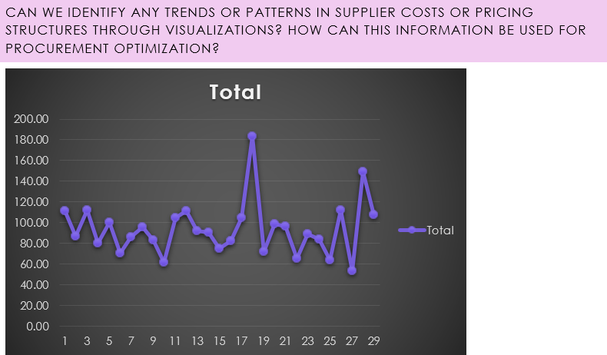
Variability in Shipping Costs: Shipping freight costs vary significantly across different suppliers, ranging from 53.43 to 183.29, indicating potential differences in shipping methods, distances, or product types.
Optimization Opportunities: Suppliers with higher freight costs, such as Supplier 18 with an average of 183.29, may benefit from cost optimization strategies and negotiations to streamline shipping expenses and improve overall cost efficiency.
Cost-Effective Suppliers: Suppliers with relatively lower average shipping freight costs, such as Suppliers 10, 22, and 25, present opportunities for maintaining cost-effective shipping solutions and fostering long-term partnerships to ensure consistent and affordable logistics service.

Slide 43
Conclusion
In summary, our deep dive into the Northwind Traders dataset has unveiled invaluable insights. From customer preferences to operational efficiencies, we've gained a holistic understanding of the business landscape. Armed with this knowledge, Northwind Traders can forge ahead with data-backed strategies. By optimizing customer experiences, refining operations, and strengthening partnerships, the company is poised for sustainable growth. The journey doesn't end here; these insights serve as a catalyst for ongoing innovation and strategic decision-making. Together, we've laid the foundation for a future where Northwind Traders thrives in a competitive market. Thank you for your engagement, and here's to a future marked by success and innovation.

Slide 44
Thanks!
Made by
Aryan Upadhyay

